Slide 1


Classification of World Countries according to Civil Aviation Capacities (CAEM)
To determine the need of each member country in the ICAO technical support.
Notes:
Present myself.
“according to” !!!!!!

Slide 2
Table of Contents
Classification according to Civil Aviation Facilities,
Classification according to Flight Traffic,
Merger between these two Classification,
Evolution & Stability of Countries.

Slide 3

What’s the percentage of 1-1-1 States in the world ?
Data Retrieval
Data Processing
Indicators Printing
→ One airport, with One runway and One airline.
→ Data bases : OAG2018 (air links) & Gilbert’s data (Runway).
→ Build a global classification with these three indicators.
Hash Table
Excel Document
Notes:
→ What do you think about if ? Majority or insignificant ? (13 %)
→ Definition of Major Airports + National Airlines.
→ Choice of Hash Table : computation speed (100,000 entries in 2018).
→ Printing, because I don’t really know what I can expect (the spreading of indicators).

Slide 4
Data Processing Phase
→ Data bases : Flights from OAG2018 & Runways from Gilbert’s data.
→ Deleting dependant or disputed territories to only keep the ICAO member states.
Country HashTab
Airport HashTab
Flight HashTab
Runway HashTab
Matching on
IATA Codes
Matching on
ISO-3 Codes
Notes:
→ IATA Codes : no ICAO codes for all airports (even new IATA codes for unreferenced airports) … “infinity” in In Guezzam, Algeria (‘INF’).
→ Oversea territories mostly, but the disputed territories are shared on the UN demarcation line (if it exists).
→ Merge of this Hash Table with the one for Airlines obtained from the OAG2018 data base.

Slide 5
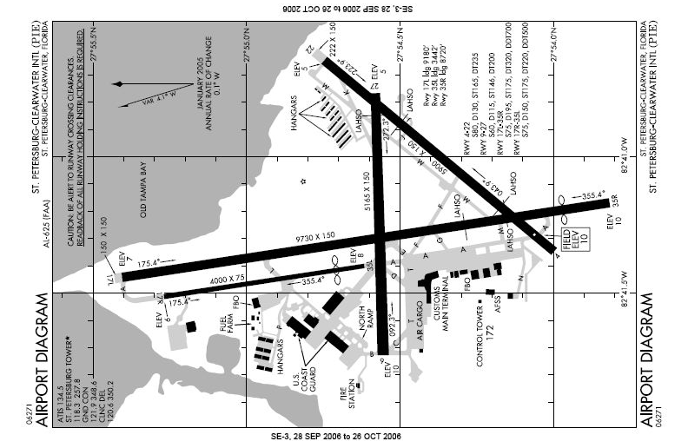
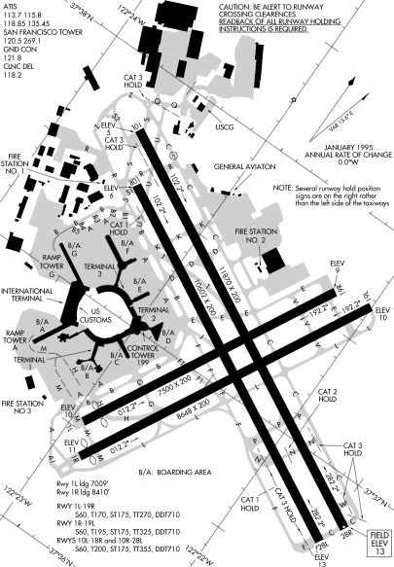
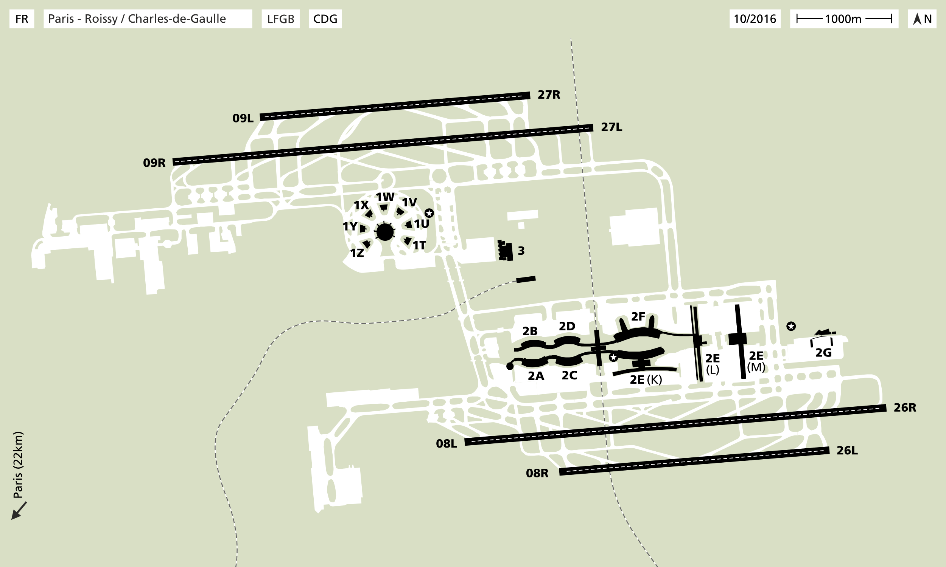
Runway Data Base
→ Maximal number of Runway by Airports.
→ Runway Index by Airports (including the layout).
Notes:
→ Runway Index : number of parallel Runways in the Airports, in adding 0.5 if there are non-parallel Runways (number of planes which can land at the time on the Airport).
→ What index do you want to define for these airports ?

Slide 6
Runway Data Base
→ Maximal number of Runway by Airports.
→ Runway Index by Airports (including the layout).
→ Global then Synthetic Runway Index.
1,5
4
2,5
Notes:
→ Global Runway Index : sum of Runway Index from every Airports in the Country (number of planes which can land at the same time in the country).
→ Synthetic Runway Index : the Global one divided by the number of Airports (average number of planes which can land at the time in a national Airport).

Slide 7
Algorithm
Gather a Set of Countries
Number of Countries ?
Not Enough
Acceptable
Too Many
Split it in several new sets
Merge it with the next one
Notes:
→ Three indicators for the Classification according Civil Aviation Facilities : Number of Airports, Runway Synthetic Index & Number of Airlines.
→ Explain the choice of 6 category, so 30 to 40 countries in each for 191.

Slide 8
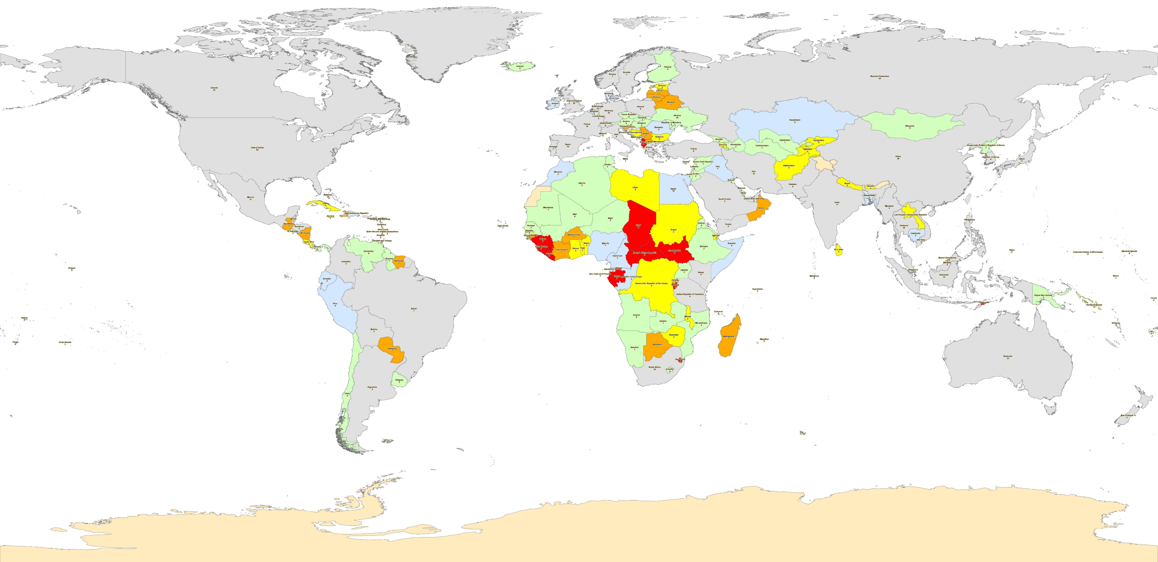
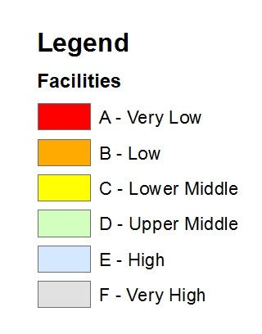
Classification according to Civil Aviation Facilities
Notes:
→ Do you see any problem in this map ? Any incorrectly classified country ? (Yemen)

Slide 9
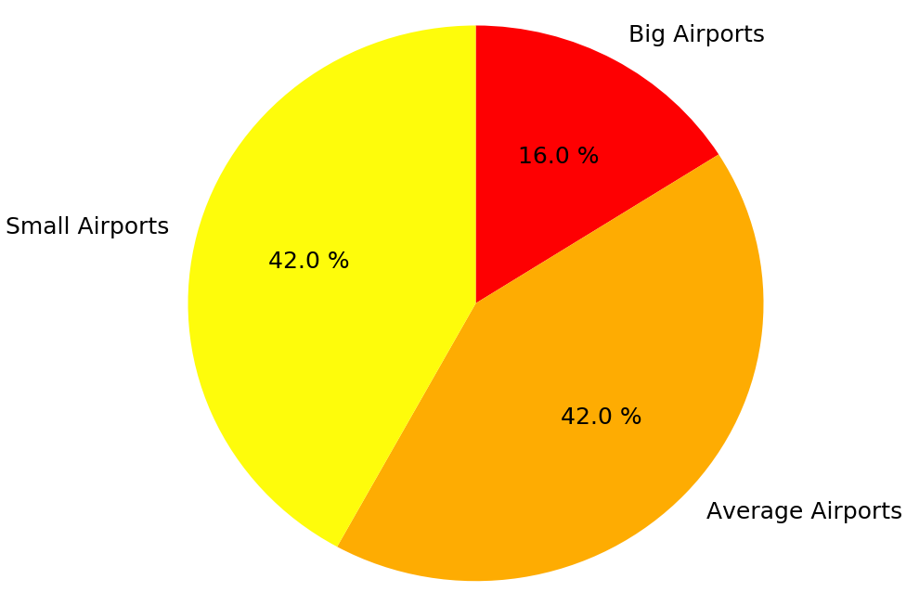
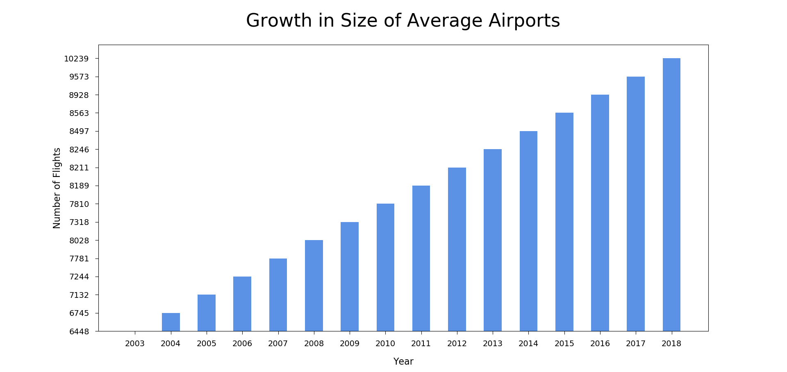
Classification according to National Flight Traffic
Number of Big Airports (> 10,000 yearly flights),
Number of Average Airports (between 1,000 & 10,000 yearly flights),
Number of Small Airports (< 1,000 yearly flights).
Notes:
→ A new classification to take in account the National Flight Traffic : airports are classified by number of flights, firstly with bounds then with percentage (to keep the classification relevant in the next years).
→ 10,000 came from FAA airport classification : a primary airport are more than 10,000 passengers.

Slide 10
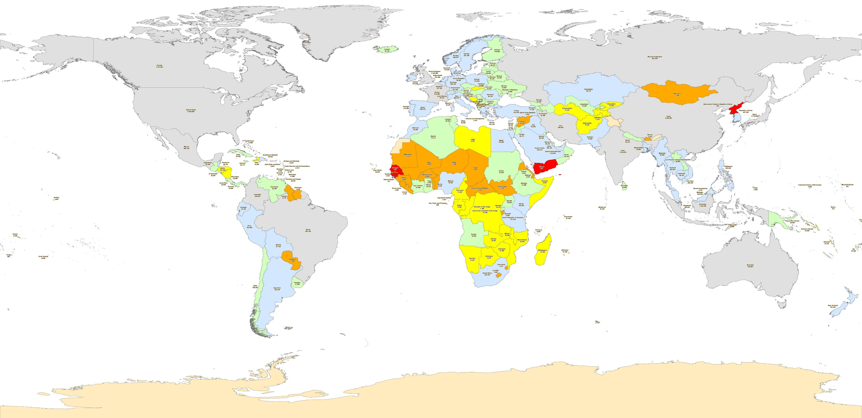
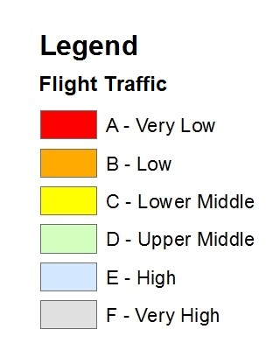
Classification according to Flight Traffic
Notes:
→ Yemen is well-classified, but Argentina is maybe a little low (fluctuate around 50 airports, so around E & F).

Slide 11
Merger
The merger is based on the ranking by wealth provided by the World Bank, based on the GNP per capita.
Category | GNI per Capita (2018 US$)
Low Income | < 1,006
Lower Middle Income | 1,006 to 3,955
Upper Middle Income | 3,956 to 12,235
High Income | > 12,235
Notes:
→ The idea : The Income of a Country determines its capacity to invest in Civil Aviation (building of Airports, subsidy to a National Airline, …).
→ The threshold are update every year to take inflation into account (in this way, the level of life linked to these income stays consistent).

Slide 12
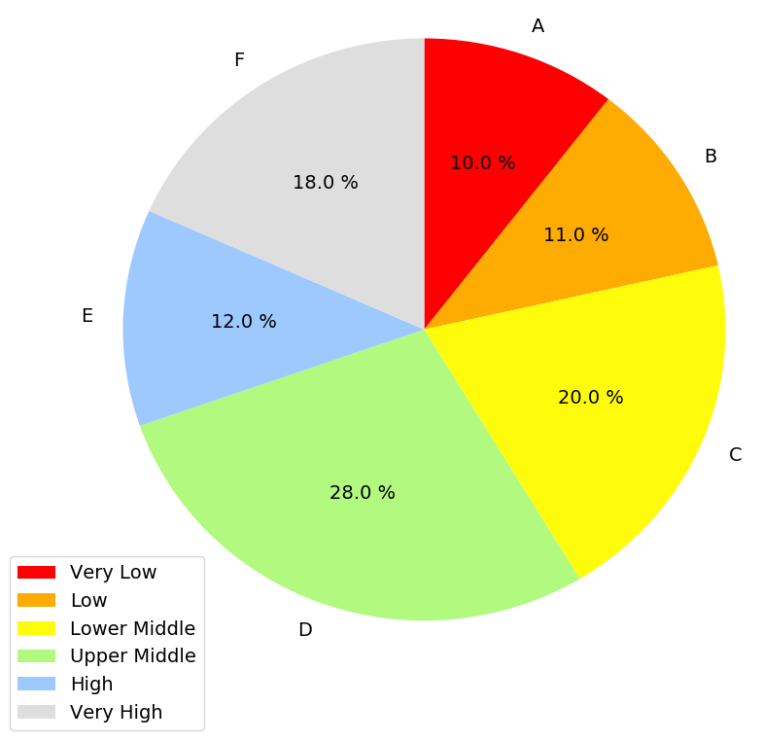

Extent of each Category in 2018
Notes:
→ The “Very Low” & “Low” categories are smaller than the others, because they are the one we want to focus on.
→ The “Very High” include 18 % of world country, which is consistent with 20% of countries overlooking the world civil aviation.

Slide 13
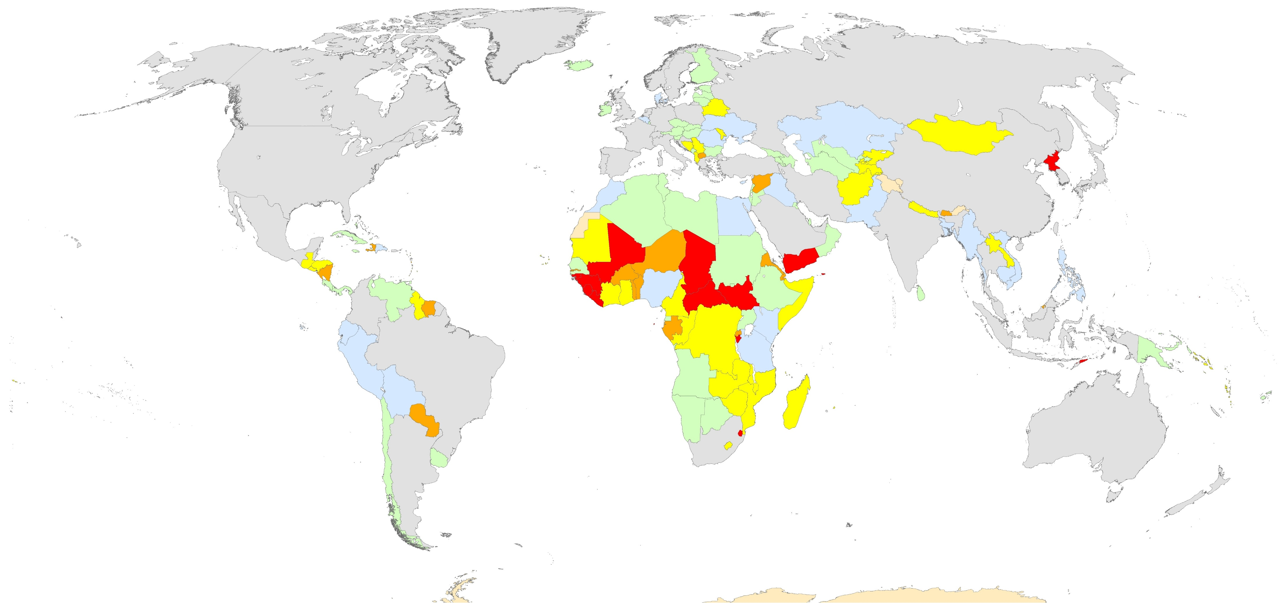
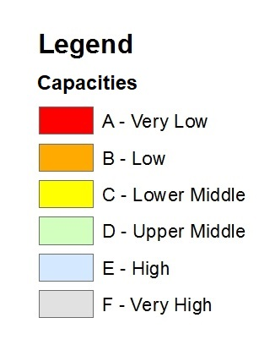
Classification according to Civil Aviation Capacities
Notes:
→ Most of the Countries in the two lower categories are Sub-Saharan. The change of projection from Equirectangular to Robinson highlight African continent and so the countries which need the more ICAO help.
→ In some country like Tanzania or some Caribbean Islands, the tourism enable a high flight traffic and a development of airports next to the most known places.

Slide 14
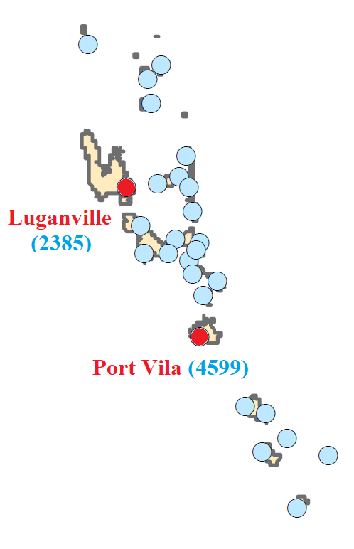
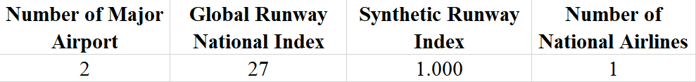
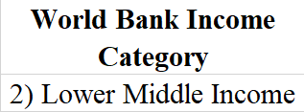
Example
Category | Description
A – Very Limited | 1 / 1 / 0
B – Limited | 1 / 1 / 1
C – Lower Middle | 1 / 1 / [2;6]
D – Upper Middle | 1 / ]1;2] / [0;9]
E – Large | 2 / [1;1.5] / [0;10]
F – Very Large | [3;113] / [1;1,567] / [1;84]
Category | Description
A – Very Low | Only small airports
B – Low | Only one average airport
C – Lower Middle | More than one average airport
D – Upper Middle | Only one big airport
E – High | More than one big airport
F – Very High | More than 50 airports
Notes:
→ 2 – 1.0 – 1, so category E in the first classification.
→ More than one average airport, so category C in the second one.
→ “Lower Middle Income”, so I keep category C.
(Passer la video !!!)

Slide 15
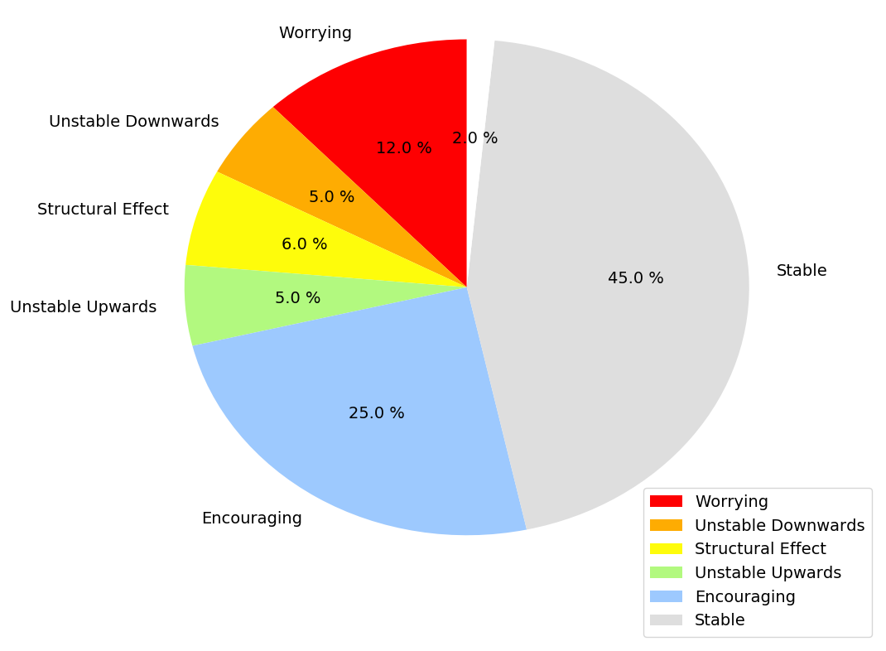
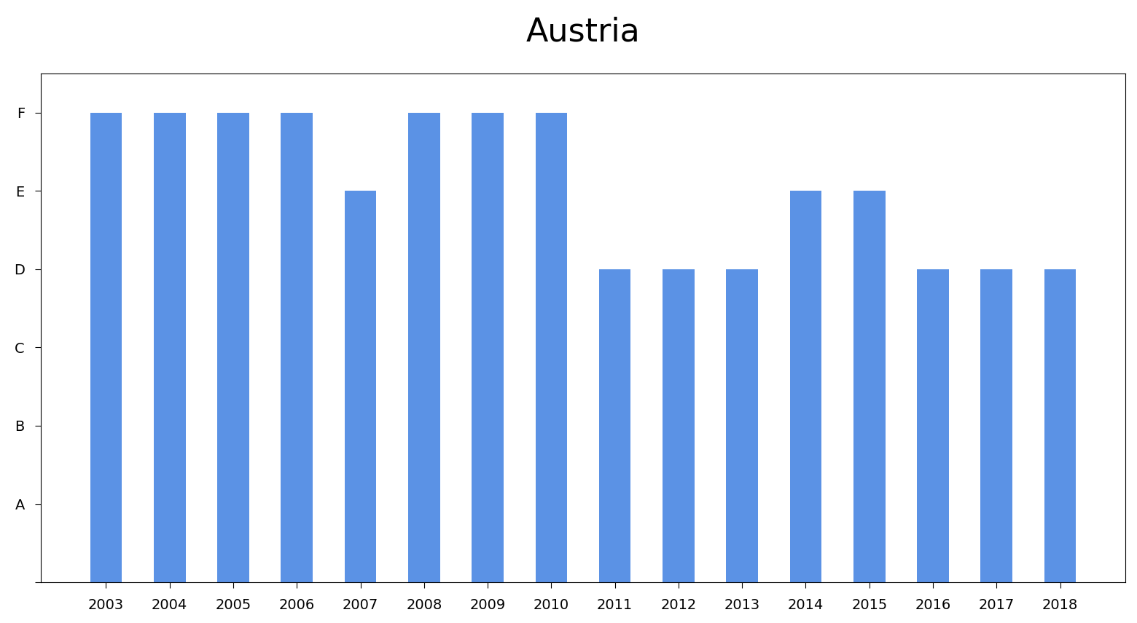
Stability Analysis
→ Evolution Index & Stability Index.
→ Underscoring of structural effects.
Notes:
→ Evolution Index : the variation of category between a previous year and the current one (a relative number).
→ Stability Index : the difference between the worst and the best category of the country during a time period (an absolute number).
→ Austria : the Austrian Flight Traffic is consistent whereas the world Flight Traffic increases (likewise Flight Traffic per Airport).

Slide 16
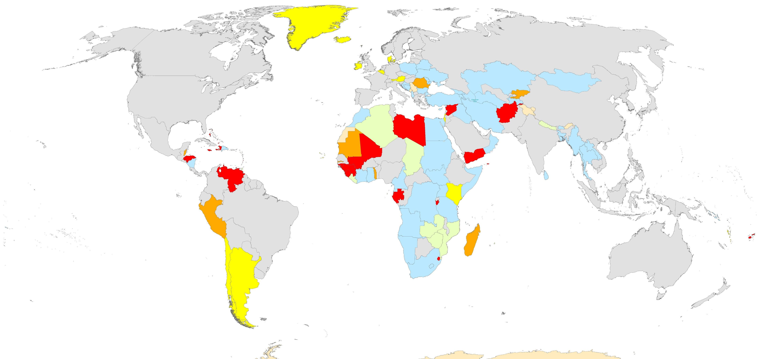
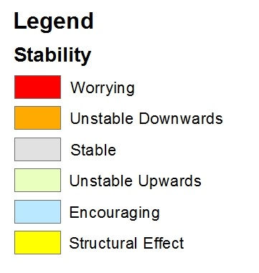
Stability Classification of World Countries
Notes:
→ Croatia : Increase of tourism caused by the EU Membership in 2013.

Slide 17
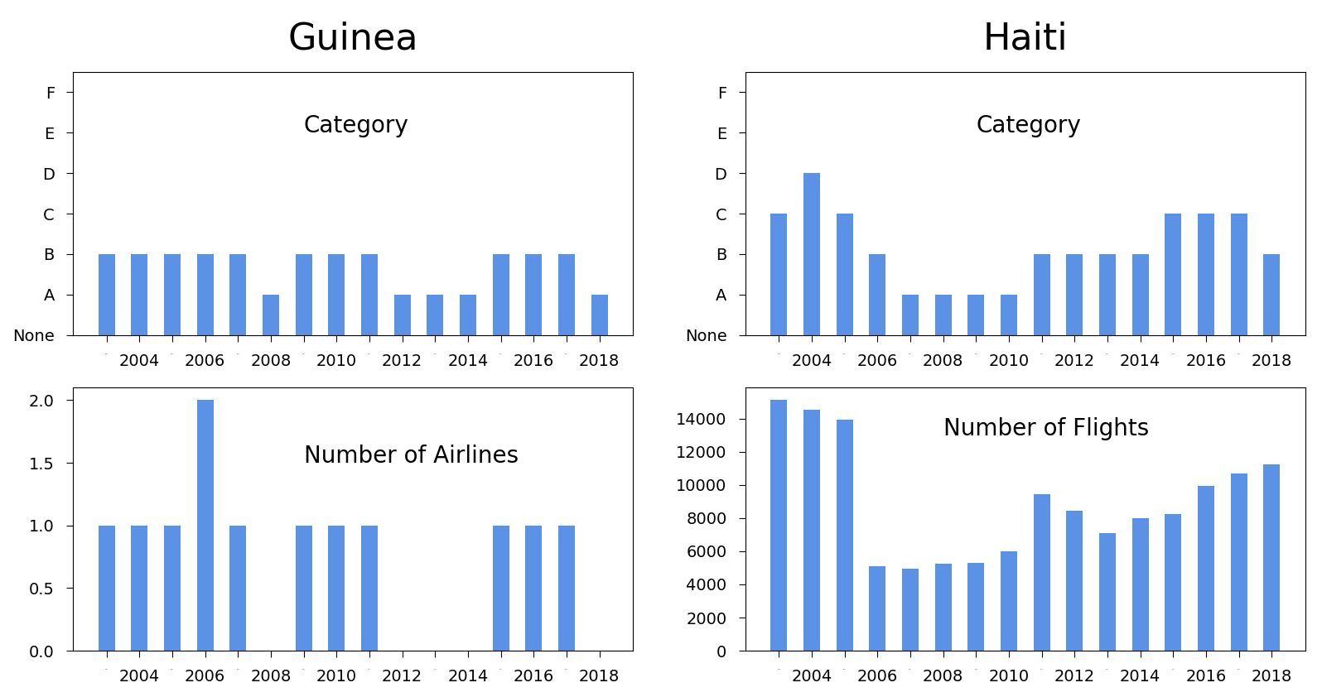
Notes:
→ Guinea : Issues with « Air Guinée » & Departure of Lansana Conté.
→ Haiti : Coup of 2004 with the departure of Aristide & Increase of tourism during Martelly Presidency with the relative stabilisation of the country.

Slide 18

Benefits from the Internship
I learnt how to use chopsticks too.
I discovered new cultures and ways of thinking : with the others interns & in visiting Canada.
I learnt a lot about how Civil Aviation works & the creation of Maps.
Notes:
→ I was very interested in the way Canadian Confederation works and the comparison we wan make with the EU.

Slide 19
